Slide 1
SinsPlay
Comp 484 Final Project
Thomas Wu
Dillon Hour

Slide 2
Problem
Most gaming websites do not have a forum page for the community to communicate.
Usually gaming websites are messy and complicated to navigate.
Websites are user friendly

Slide 3
Motivation
Create a more user friendly site
Build a community within the game
Problem solving within the community
Add games to the website that company has created

Slide 4
Approach
Bootstrap 3.3
Xampp (PHP, MySQL, Apache)
GoDaddy for hosting

Slide 5
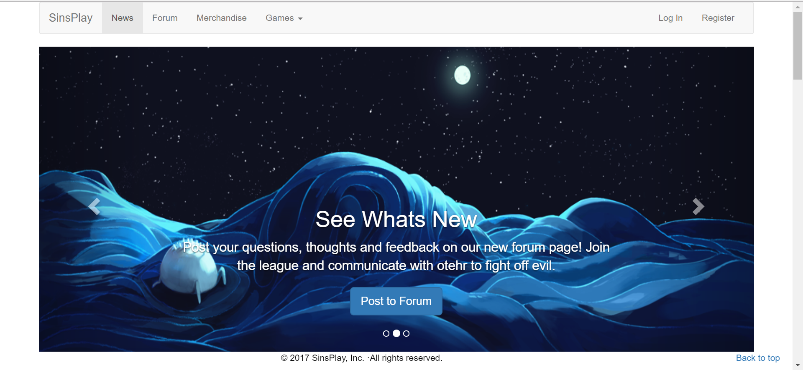
Landing Page

Slide 6
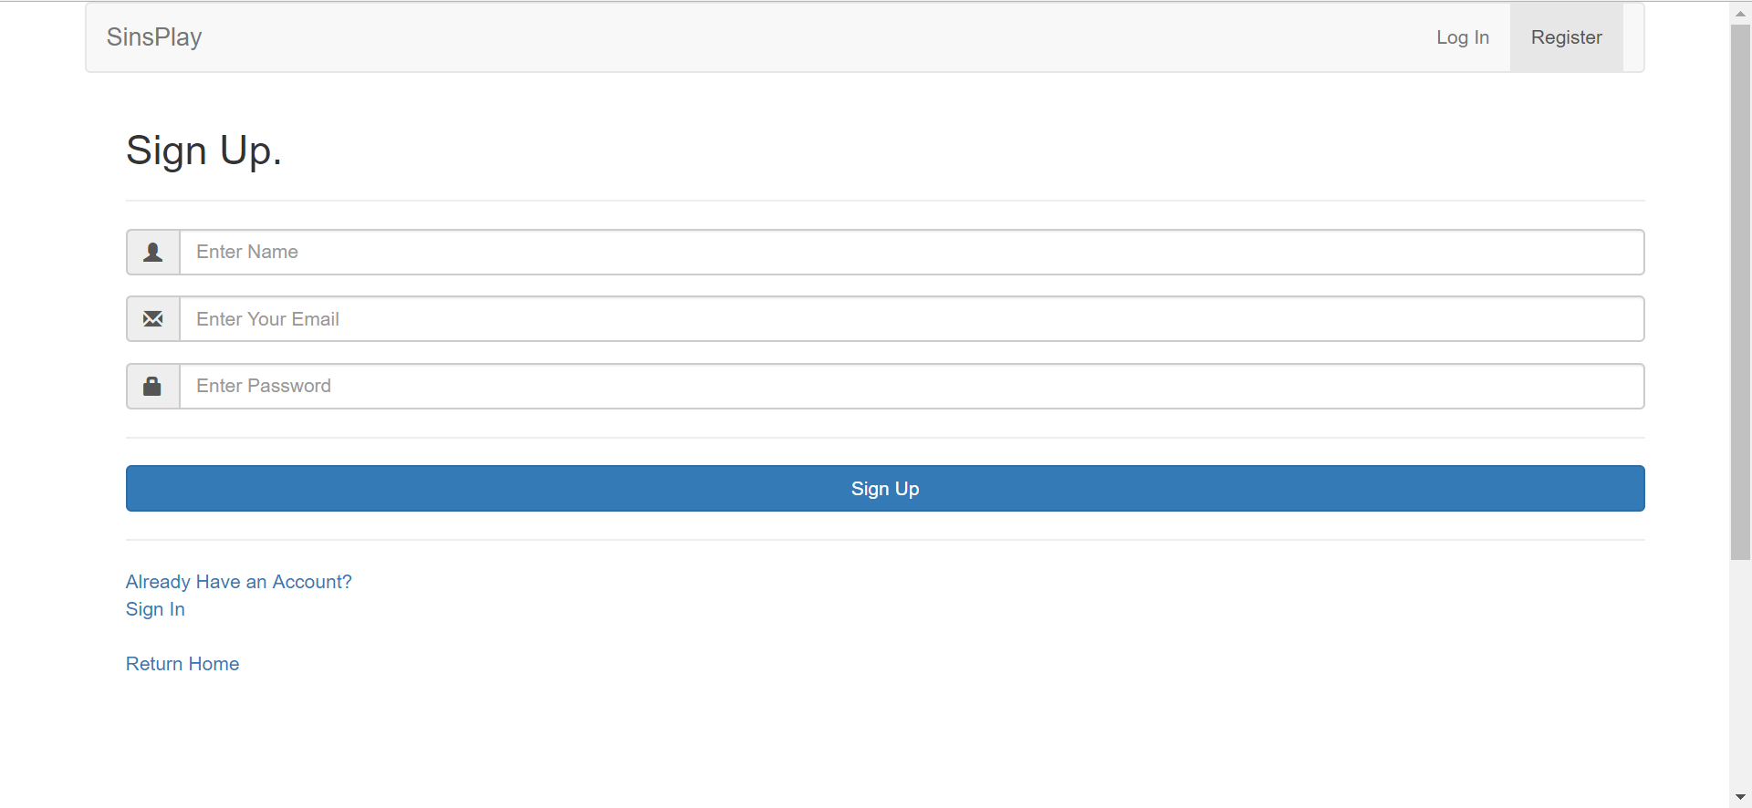
Sign Up Page

Slide 7
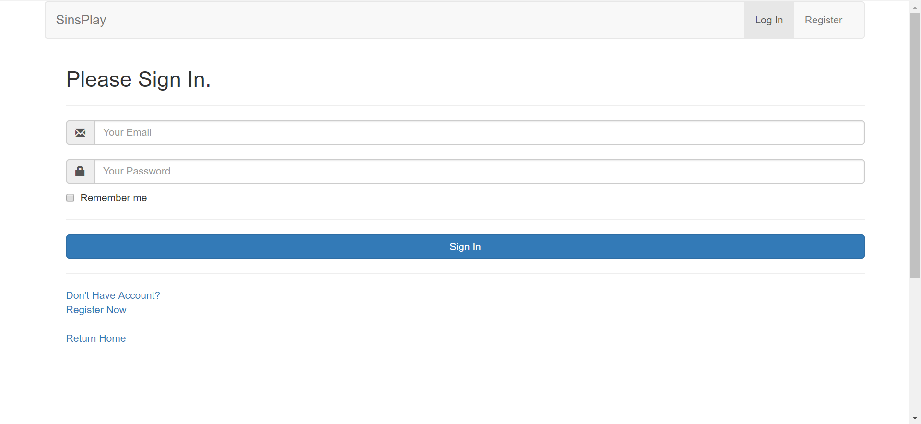
Sign In Page

Slide 8
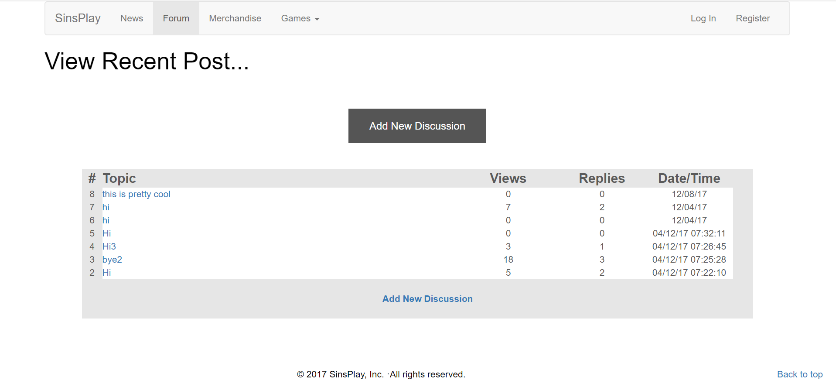
Forum Page

Slide 9
Future Work
Functioning Merchandise Page
More available games
Chat Room for the community
Live leaderboard page

